Slide 1
Save A Byte:
Innovation to End Food Waste
Meet the Driving Force
Project Lead
Safyal Muznabin Ratul
Design & UX
Sumaiya Sadika
Donor Relations
Sourav Saha
Operations & Integration
Saptarshi Biswas Supty
Tech & Architecture
Urbashi BIswas

Slide 2
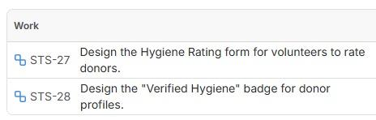
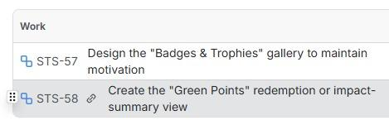
Safyal Muznabin Ratul
Engineer & Analytics Lead
Sprint 1
Donor Hygiene & Feedback
Sprint 2
Gamification Profile

Slide 3
Safyal Muznabin Ratul
Engineer & Analytics Lead
Sprint 3
Donor Hygiene & Feedback
Sprint 4
Gamification Profile

Slide 4
Sumaiya Sadika
Design & Branding Visionary
Sprint 1
Donor Hygiene & Feedback
Sprint 2
Gamification Profile

Slide 5
Sumaiya Sadika
Design & Branding Visionary
Sprint 3
Donor Hygiene & Feedback
Sprint 4
Gamification Profile

Slide 6
Urbashi Biswas
Architecture & Logistics Expert
Sprint 1
Donor Hygiene & Feedback
Sprint 2
Gamification Profile

Slide 7
Urbashi Biswas
Architecture & Logistics Expert
Sprint 3
Donor Hygiene & Feedback
Sprint 4
Gamification Profile

Slide 8
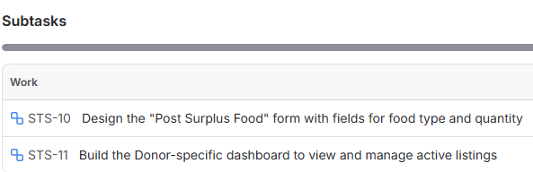
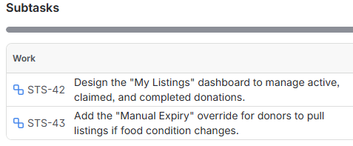
Sourav Saha
Donor Relations & Engagement
Sprint 1
Donor System Management
Sprint 2
Donor Surplus Control

Slide 9
Sourav Saha
Donor Relations & Engagement
Sprint 3
Donor Hygiene & Feedback
Sprint 4
Gamification Profile

Slide 10
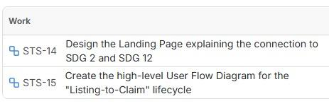
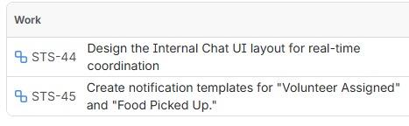
Saptarshi Biswas Supty
Operations & Integration Strategist
Sprint 1
Communication & Impact Hub
Sprint 2
Private Coordination Hub

Slide 11
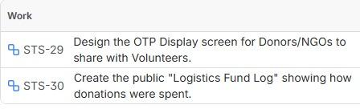
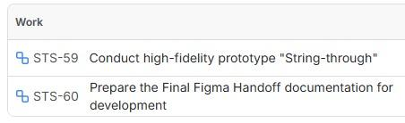
Saptarshi Biswas Supty
Operations & Integration Strategist
Sprint 3
Financial Transparency & Verification
Sprint 4
Final System Integration

Slide 12
THANK
YOU!

